Slide 1
Digestive System
National Junior Swine Association
Skillathon Resource

Slide 2
Learning Objectives
Identify various parts of the digestive system.
Explain the difference between a monogastric animal and a ruminant animal.
Explain various functions of parts of the digestive system.

Slide 3
Mongastric vs. Ruminant
A monogastric animal has a single-chambered stomach and a much simpler digestive tract.
  Swine are monogastric
A ruminant animal has a four-chambered stomach with a much more complex digestive tract.
  Cattle are ruminants

Slide 4
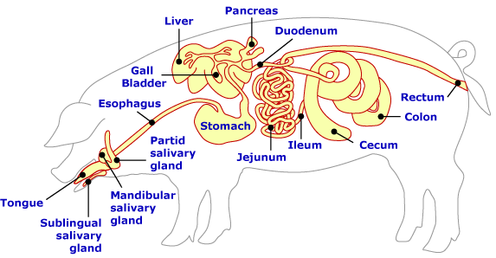
Layout of the Digestive System
Study this diagram to be able to identify the various parts of the digestive system.

Slide 5
Tongue and Salivary Glands
The tongue serves as the first step to generate saliva and it helps push food toward the esophagus.
Sublingual, mandibular, and parotid salivary glands all work together to create saliva.
Saliva is a watery, mucus-like secretion of the salivary glands in the mouth that lubricates the food and aids in digestion.
It contains an enzyme that helps break down starch.

Slide 6
Tongue and Salivary Glands

Slide 7
Esophagus
The esophagus is a tube which carries the food from the mouth to the stomach.
Muscle contractions push the food toward the stomach.
Swallowing is the first of these contractions.
At the end of the esophagus is the cardiac valve, which prevents food from passing from the stomach back into the esophagus.

Slide 8
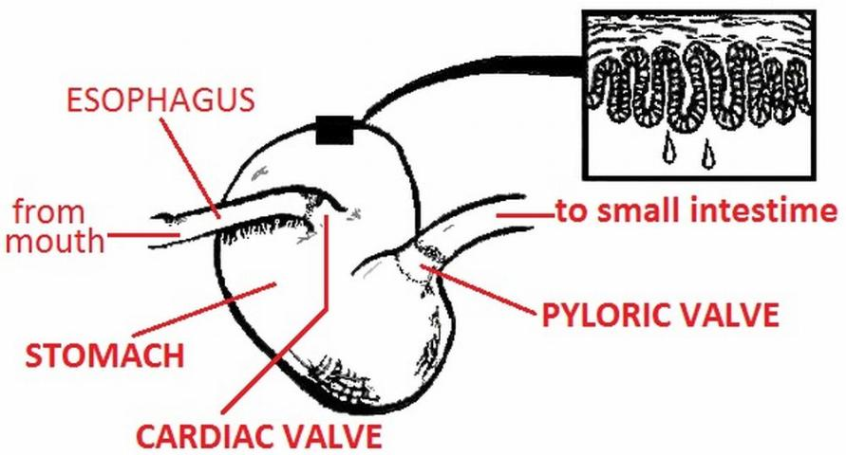
Esophagus

Slide 9
Stomach
The stomach is a reaction chamber where chemicals are added to the food.
Certain cells along the stomach wall secrete hydrochloric acid and enzymes.
  These chemicals help break down food into small particles.
Particles that the stomach cannot absorb into the bloodstream pass in to the small intestine through the pyloric valve.

Slide 10
Stomach

Slide 11
Gall Bladder, Liver, Pancreas, and Duodenum
The gall bladder serves as a storage compartment for bile.
Bile is secreted by a gland called the liver, and bile assists in the digestion of fats.
The pancreas is another gland that secretes juices that aid in the digestion of fats, carbohydrates, and proteins.
These secretions are added in the duodenum, which is the first section of the small intestine.

Slide 12
Gall Bladder, Liver, Pancreas, and Duodenum

Slide 13
Small Intestine and Cecum
The small intestine assists in the absorption of nutrients.
It contains two other parts, the jejunum and the ileum.
  The jejunum is the middle or intermediate part of the small intestine.
  The ileum is the final portion of the small intestine.
Between the ileum and the large intestine is a “blind gut” referred to as the cecum.
There is no primary role for this in swine, but in some monogastric animals, it aids in the digestions of fibrous materials.

Slide 14
Small Intestine and Cecum
Small Intestine

Slide 15
Large Intestine
The large intestine’s main function is the absorption of water.
Mucous is added to the remaining food in order to make passage easier.
The colon is the largest portion of the large intestine and plays a major role in water absorption and formation of feces.
Muscle contractions push food through the intestines.

Slide 16
Large Intestine

Slide 17
Rectum and Anus
The rectum is the final portion of the large intestine.
It is a straight tube of the large intestine that forms solid waste.
The anus is the final part of the digestive tract to excrete undigested food from the body.

Slide 18
Rectum and Anus

Slide 19
Now that you have learned about the digestive tract, take this quiz to see what you have learned!
Start Quiz!

Slide 20
1. Pigs are monogastric animals which means they only have a single-chambered stomach.
TRUE
FALSE

Slide 21
Correct!
Keep working through the quiz to see what you know!
Next Question

Slide 22
Try Again!
Remember to look back in the slides to refresh your memory!
Try Again!

Slide 23
2. The jejunum and ileum are a part of the large intestine.
TRUE
FALSE

Slide 24
Correct!
Keep working through the quiz to see what you know!
Next Question

Slide 25
Try Again!
Remember to look back in the slides to refresh your memory!
Try Again!

Slide 26
3. The straight tube that forms solid waste and prepares waste for excretion is called the _____________.
Anus
Rectum
Colon
Cecum

Slide 27
Correct!
Keep working through the quiz to see what you know!
Next Question

Slide 28
Try Again!
Remember to look back in the slides to refresh your memory!
Try Again!

Slide 29
4. At the end of the esophagus is the ___________ that helps prevent food from reentry into the esophagus.
Cardiac Valve
Pyloric Valve
Cecum
Ileum

Slide 30
Correct!
Keep working through the quiz to see what you know!
Next Question

Slide 31
Try Again!
Remember to look back in the slides to refresh your memory!
Try Again!

Slide 32
5. The main function of the liver is to secrete _______________.
Saliva
Juice
Water
Bile

Slide 33
Correct!
Keep working through the quiz to see what you know!
End Quiz!

Slide 34
Try Again!
Remember to look back in the slides to refresh your memory!
Try Again!

Slide 35
Congratulations!
You have completed the “Digestive System” resource! Great work! Keep going through the resources to learn more about swine!

